Slide 1
Orthopedic Surgery
Gaming App
Nicholas Duffner, Amber Graham, Chenning Zheng
Notes:
Cole intro

Slide 2

Problem 1: Engaging Teen Students
High School students are not commonly exposed to Orthopaedic Surgery until their college years
For many, by then it is too late
Existing courses of similar subjects (Anatomy, Biology) do not introduce students to aspects of Orthopaedic Surgery
Public schools don’t offer classes specific to surgery
Closest application of surgery is dissection of smaller animals
Notes:
Cole

Slide 3
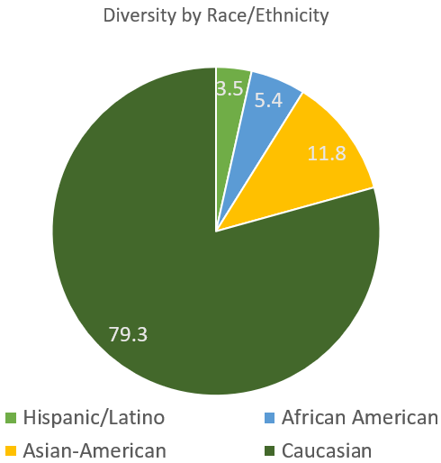
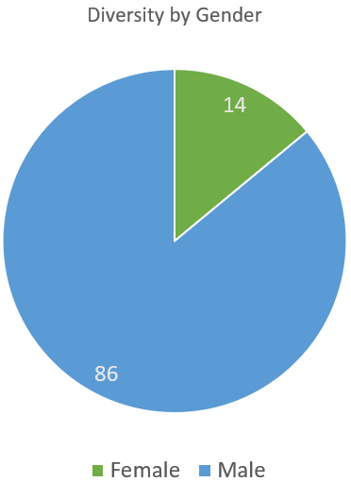
Problem 2: Lack of Diversity
Only about 1 in 10 orthopaedic surgeons are women
More males are introduced to the field at a young age because of sports
Women and minorities are not as exposed to the field for several different factors
American Academy of Orthopedic Surgeons
Notes:
Amber

Slide 4
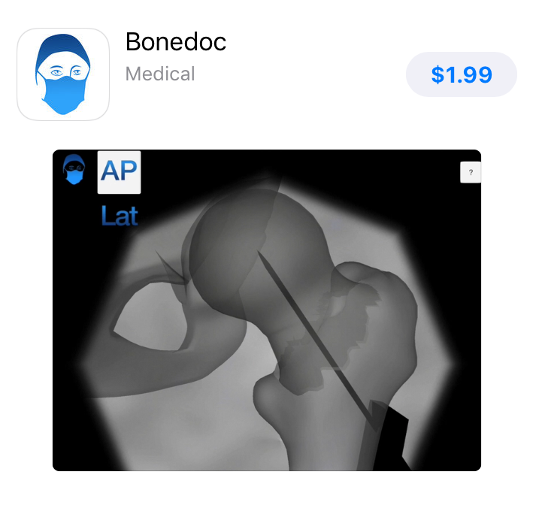
Other Solutions: Apps
An existing Orthopedic Surgery Gaming App is Bonedoc
Price is $1.99, so it is unlikely that high school students would play it
Geared toward actual surgeons, not our target customer group
Only available for Apple, not available for Android
Does not contain any form of anatomy education, which is one of the goals of our project (iMedicalApps).
There are no existing apps accomplishing what our sponsors are aiming for
Notes:
Amber

Slide 5
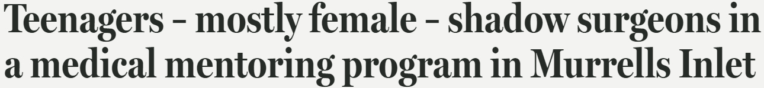
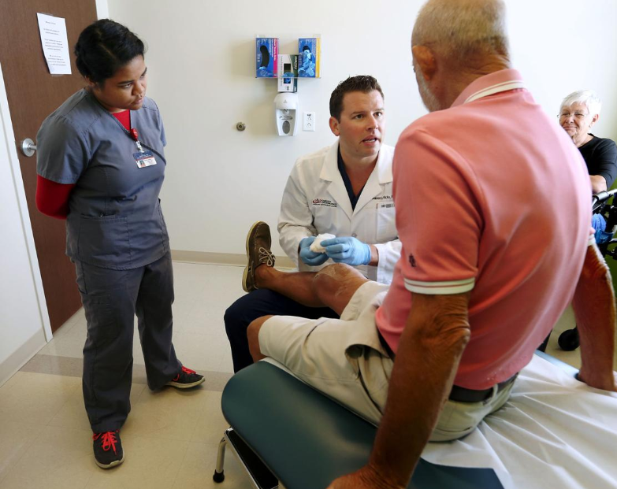
Other Solutions: Shadowing Programs
Gave teen students the opportunity to explore the everyday activities of an orthopaedic surgeon
Programs put a specific emphasis on female teens in order to increase diversity.
All 38 students in the Stanford program were female while 50 of 55 were female from South Carolina program
Programs were very successful and students were engaged, but these programs do not reach a wide range of students.
Notes:
Amber

Slide 6
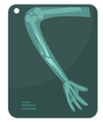
How We Will Solve The Problem: Make Surgery Fun
Make the game cartoonish
Include specific trauma scenarios to make the game entertaining
The game will be interactive to give the students a hands-on experience
Show the grade that they got in the game to encourage them to do better.
Notes:
Chenning

Slide 7

How We Will Solve The Problem: Make the App Inclusive
Free to download
Available on iOS and Android
Neutral color-scheme
Gender-neutral graphics
Available offline - no data/wifi connection to play
Teaches the anatomy so all can learn
Notes:
Chenning

Slide 8
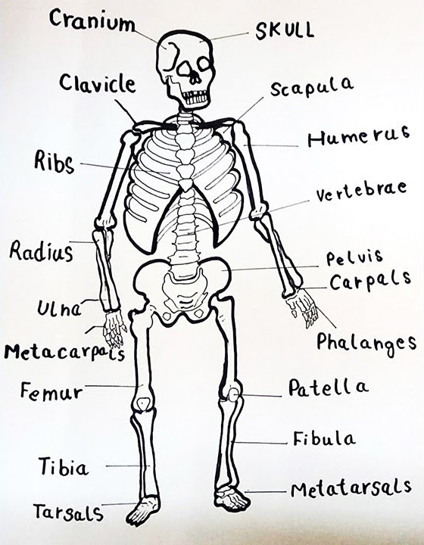
How We Will Solve The Problem: Creating a Fun and Informative App
Include entertaining/cartoonish graphics
Ensure accuracy of medical terms so that information is correct
Hire a Graphic Designer to make the visuals more appealing
Anatomy Quiz will allow students to have a background on the topics of the main game
Main game will have different scenarios that will test the student’s knowledge of surgery
Players will receive a score at the end of the game based on how many they got right
Students will be naturally inclined to improve their score
Playing often will make them more informed
How to Draw
Notes:
Chenning

Slide 9

How We Will Solve The Problem: Code Development
Utilizing Unity to develop the code
We will take an Agile approach and develop in sprints to go section by section, ensuring smooth integration.
This approach will also allow us to make changes more easily, should any arise.
Unity provides ability to develop in iOS and Android with simulation that will be very valuable for testing.
This software is easy enough to use, allowing us to reach our time goal, while also being complex enough to allow for needed customizations.
Notes:
Cole, C#, more accessible as mentioned

Slide 10
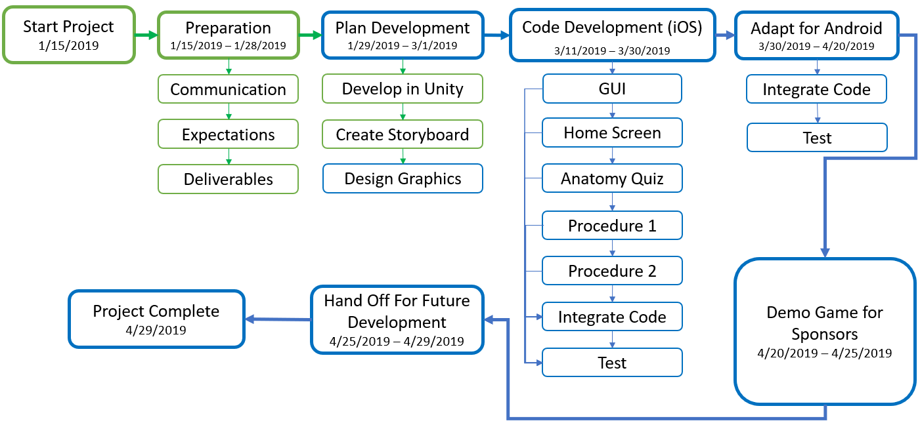
Project Plan
Notes:
Amber

Slide 11

Risks
Inadequate testing - we miss bugs
Copyright violation we missed.
Missing the mark on engaging high school students
Financial planning for future expansion and publishing
Notes:
Cole

Slide 12
Questions?
Notes:
Cole

Slide 13
Thank you!

Slide 14
Citations
Slide 2 - Image: Care for the Family, https://www.careforthefamily.org.uk/family-life/parent-support/everyday-parenting/whats-going-on-in-your-teenagers-head
Slide 3 - Statistics: American Academy of Orthopedic Surgeons, https://aaos.org/AAOSNow/2017/Jul/Clinical/clinical06/?ssopc=1
Slide 4 - Information: iMedicalApps, https://www.imedicalapps.com/2014/04/bonedoc-game-orthopedic-surgeons/ Slide 5 - Second Headline: Stanford Medicine, https://scopeblog.stanford.edu/2013/08/20/teen-girls-become-orthopaedic-surgeons-for-a-day/
Slide 5 - First Headline and Image: The Post and Courier, https://www.postandcourier.com/health/teenagers-mostly-female-shadow-surgeons-in-a-medical-mentoring-program/article_94e0636a-7ba3-11e7-a303-2fe745a41cfb.html Slide 6 - Image: VectorStock, https://www.vectorstock.com/royalty-free-vector/bone-injury-x-ray-cartoon-icons-collection-vector-13575187
Slide 7 - Image: OrangeMantra, https://www.orangemantra.com/blog/android-vs-ios-which-os-to-be-preferred-for-making-your-app/
Slide 8 - Image: How to Draw, https://www.youtube.com/watch?v=-7pOnkUFE-Q
Slide 9 - Image: Unity, https://unity3d.com
Slide 11 - Image: How to Find Bugs in MySQL, https://www.percona.com/blog/2014/04/17/how-to-find-bugs-in-mysql/

